Slide 1
Inheritance in C++ (Part-01)

Slide 2
Inheritance
The capability of a class to derive properties and characteristics from another class is called Inheritance.
Inheritance is one of the most important feature of Object-Oriented Programming.
Sub Class: The class that inherits properties from another class is called Sub class or Derived Class.
Super Class: The class whose properties are inherited by sub class is called Base Class or Super class.

Slide 3

Why and When to Use Inheritance
Consider a group of vehicles. You need to create classes for Bus, Car and Truck. The methods fuelAmount(), capacity(), applyBrakes() will be same for all of the three classes.
If we create these classes avoiding inheritance then we have to write all of these functions in each of the three classes as shown in below figure:

Slide 4
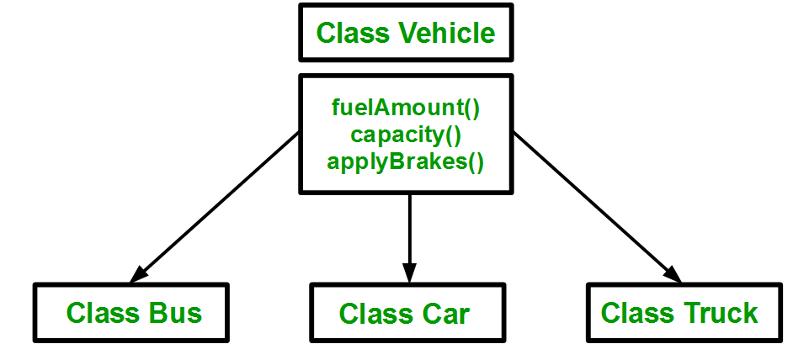
Why and When to Use Inheritance
You can clearly see that above process results in duplication of same code 3 times. This increases the chances of error and data redundancy. To avoid this type of situation, inheritance is used. If we create a class Vehicle and write these three functions in it and inherit the rest of the classes from the vehicle class, then we can simply avoid the duplication of data and increase re-usability. Look at the below diagram in which the three classes are inherited from vehicle class:

Slide 5
Why and When to Use Inheritance?
Using inheritance, we have to write the functions only one time instead of three times as we have inherited rest of the three classes from base class(Vehicle).
Inheritance is a term for reusing code by a mechanism of passing down information and behavior from a parent class to a child or subclass.

Slide 6
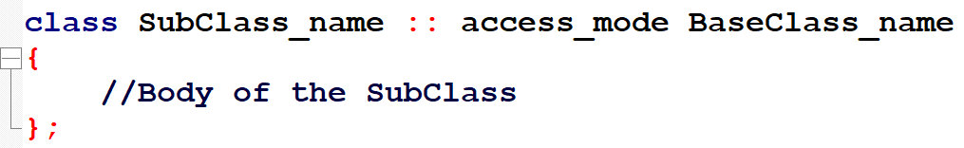
Implementing Inheritance in C++
Implementing inheritance in C++: For creating a sub-class which is inherited from the base class we have to follow the below syntax.
Here, Subclass_name is the name of the sub class, access_mode is the mode in which you want to inherit this sub class for example: public, private etc. and BaseClass_name is the name of the base class from which you want to inherit the sub class.

Slide 7
Modes of Inheritance
Public mode: If we derive a sub class from a public base class. Then the public member of the base class will become public in the derived class and protected members of the base class will become protected in derived class.
Protected mode: If we derive a sub class from a Protected base class. Then both public member and protected members of the base class will become protected in derived class.
Private mode: If we derive a sub class from a Private base class. Then both public member and protected members of the base class will become Private in derived class.

Slide 8
Modes of Inheritance
The below table summarizes the above three modes and shows the access specifier of the members of base class in the sub class when derived in public, protected and private modes:
Base Class member Access Specifier | Type of Inheritance
 | Public | Protected | Private
Public | Public | Protected | Private
Protected | Protected | Protected | Private
Private | Not Accessible (Hidden) | Not Accessible (Hidden) | Not Accessible (Hidden)

Slide 9
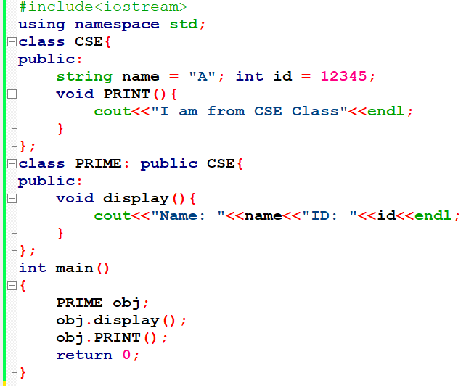
Properties of Base Class: Public, Mode: Public

Slide 10
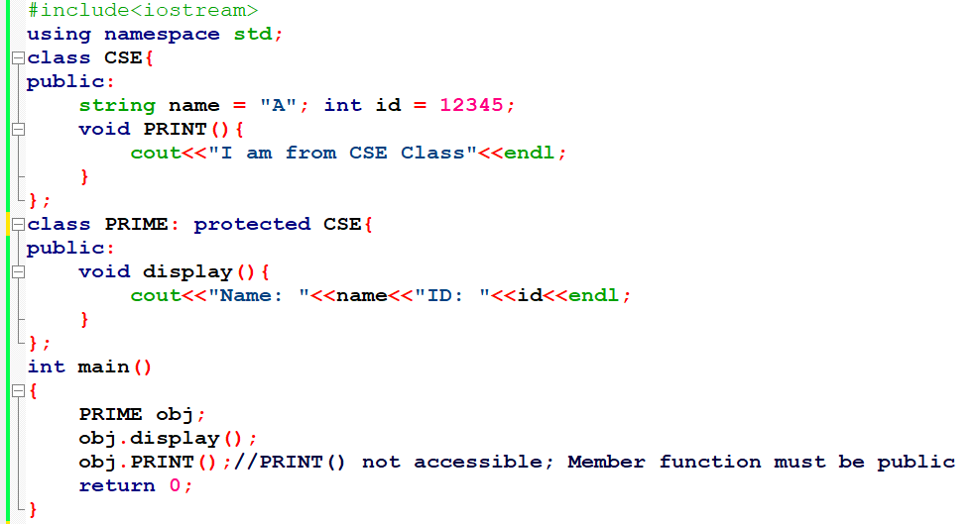
Properties of Base Class: Public, Mode: Protected

Slide 11
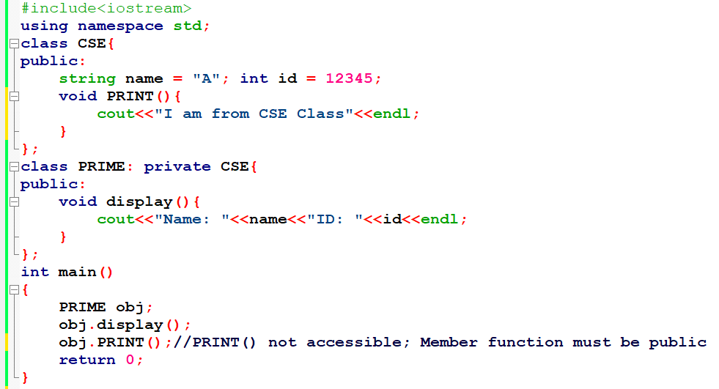
Properties of Base Class: Public, Mode: Private

Slide 12
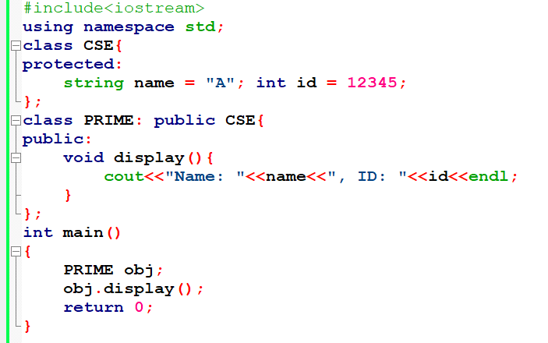
Properties of Base Class: Protected, Mode: Public

Slide 13
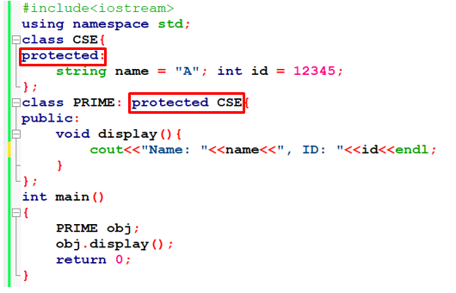
Properties of Base Class: Protected, Mode: Protected

Slide 14
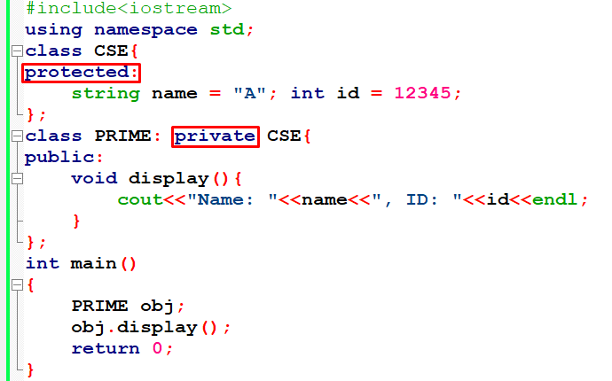
Properties of Base Class: Protected, Mode: Private

Slide 15
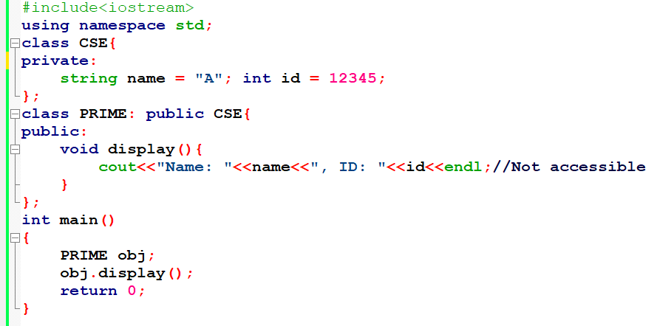
Properties of Base Class: private, Mode: Public

Slide 16
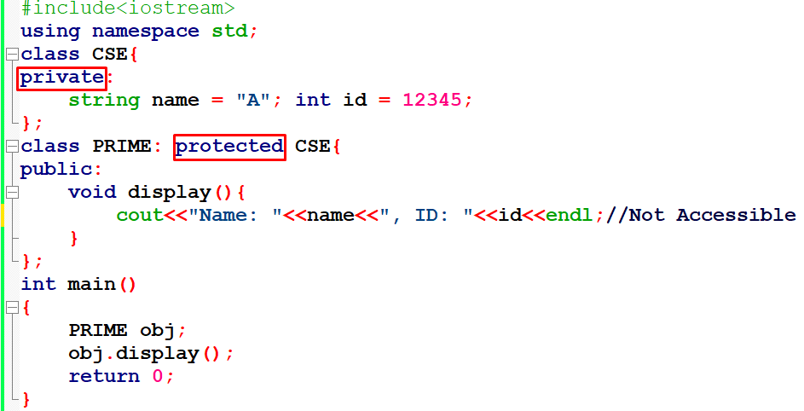
Properties of Base Class: private, Mode: Protected

Slide 17
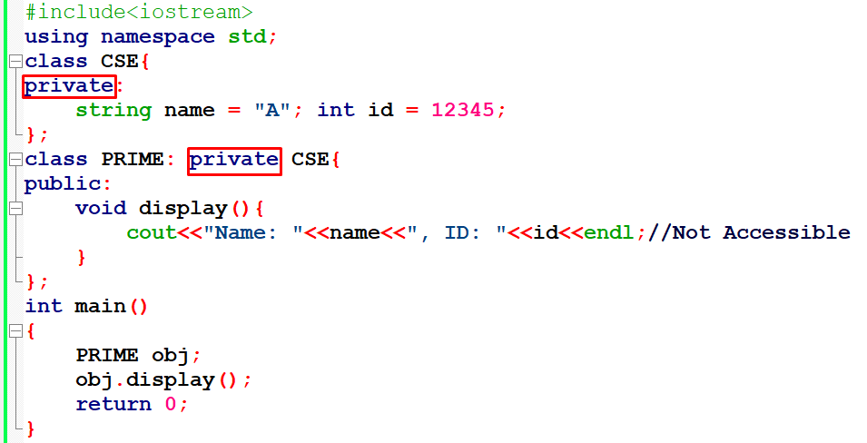
Properties of Base Class: private, Mode: Private

Slide 18
Again, Modes of Inheritance
The below table summarizes the above three modes and shows the access specifier of the members of base class in the sub class when derived in public, protected and private modes:
Base Class member Access Specifier | Type of Inheritance
 | Public | Protected | Private
Public | Public | Protected | Private
Protected | Protected | Protected | Private
Private | Not Accessible (Hidden) | Not Accessible (Hidden) | Not Accessible (Hidden)

Slide 19
Types of Inheritance

Slide 20
Types of Inheritance in C++
Single Inheritance
Multiple Inheritance
Multilevel Inheritance
Hierarchical Inheritance
Hybrid Inheritance (Virtual Inheritance)

Slide 21
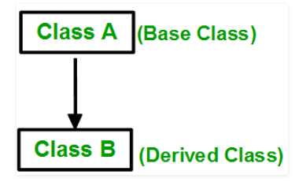
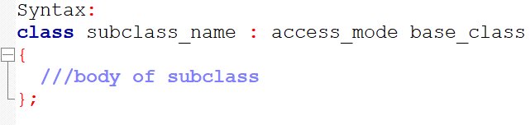
Single Inheritance
In single inheritance, a class is allowed to inherit from only one class. i.e. one sub class is inherited by one base class only.

Slide 22
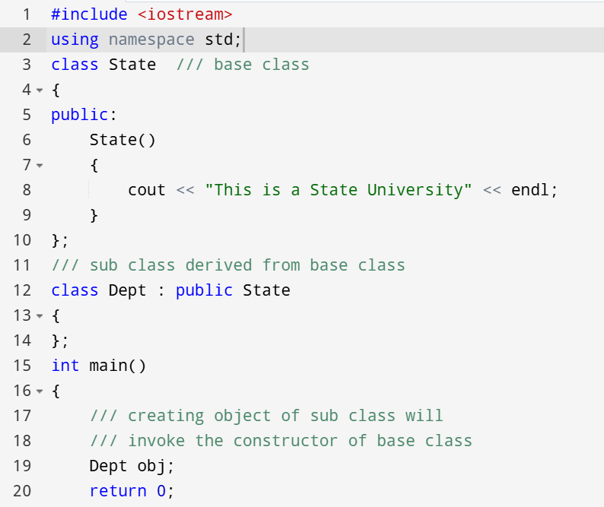
Single Inheritance

Slide 23

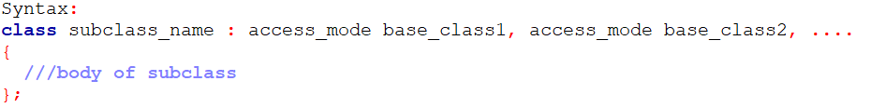
Multiple Inheritance
Multiple Inheritance is a feature of C++ where a class can inherit from more than one classes. i.e one sub class is inherited from more than one base classes.

Slide 24
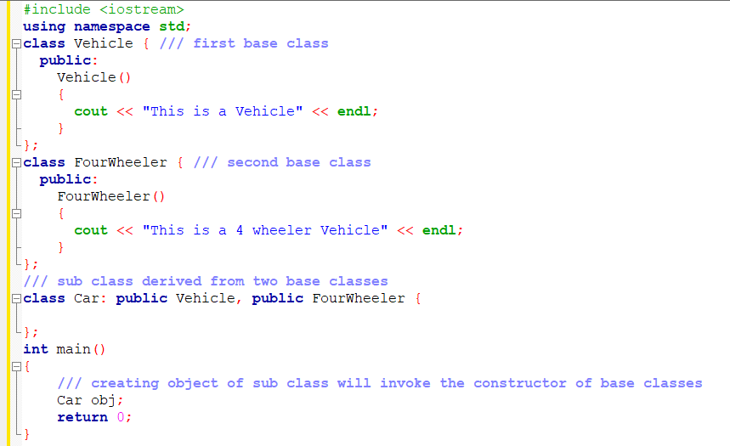
Multiple Inheritance

Slide 25
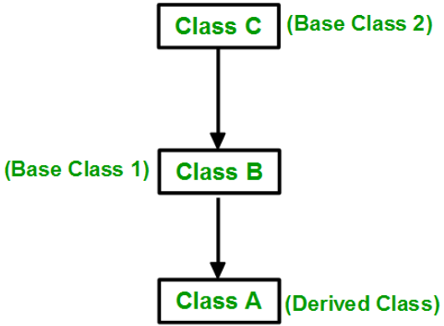
Multilevel Inheritance
In this type of inheritance, a derived class is created from another derived class.

Slide 26
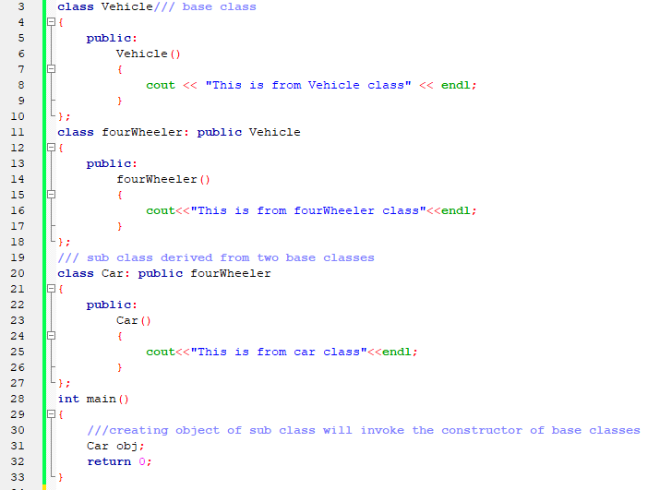
Multilevel Inheritance

Slide 27
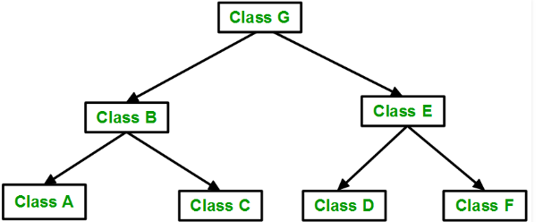
Hierarchical Inheritance
In this type of inheritance, more than one sub class is inherited from a single base class. i.e. more than one derived class is created from a single base class.

Slide 28
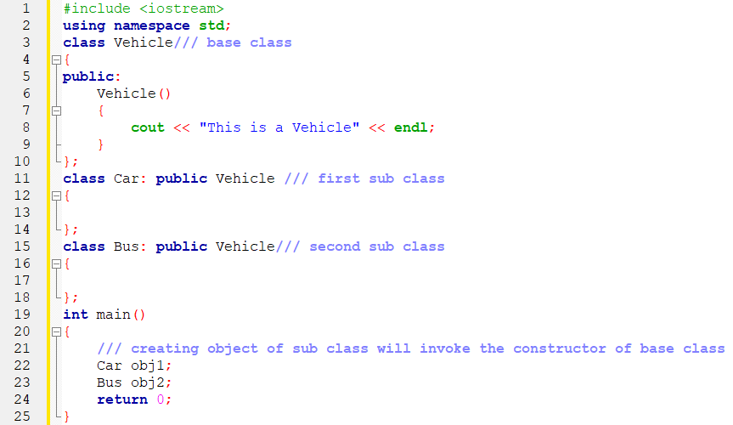
Hierarchical Inheritance

Slide 29
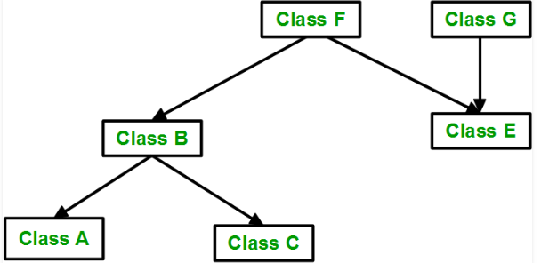
Hybrid(Virtual) Inheritance
Hybrid Inheritance is implemented by combining more than one type of inheritance.

Slide 30
Hybrid(Virtual) Inheritance
Hybrid Inheritance is implemented by combining more than one type of inheritance.

Slide 31
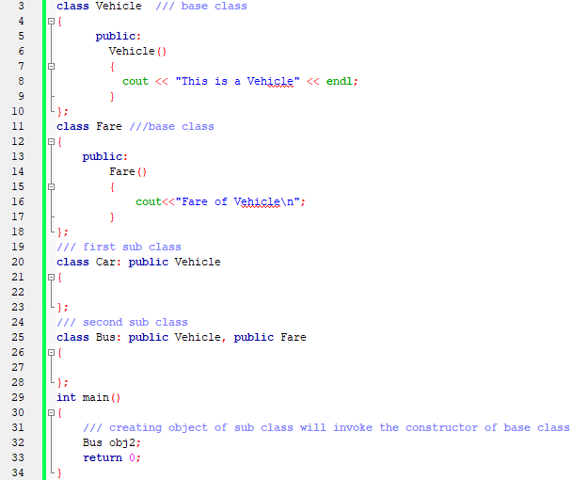
Hybrid(Virtual) Inheritance

Slide 32
Thank You

